Slide 1
Practicum Presentation on Demonetisation
By:
Swapnil Vermani

Slide 2
1) Executive Summary (Abstract)
Motivation : The effects of demonetisation of 500 and 1000 Rs notes on India.
Method: This report is based on RBI’s official transactional data across various payment methods over three years(2015-2018) and also twitter data of past week as well as for short span of time when demonetisation was announced.
Message: Whether it was a bad move or not.
Means: TextBlob, Tweepy, Rstudio, Tableau, Matplotlib

Slide 3
2) Business Problem
Business Understanding
The opinions and the effects a government policy had on Indian citizens and their economy.
To critique on the fact that “Was it all worth it ? ”
Analytics Approach
The problems caters sentimental analysis about demonetization, its effect on socio-economic factors and growth of cashless economy.

Slide 4
3) Data Requirements & Collections
Data Requirements
RBI transactional data for over three years (2015-2018)
Twitter data for past week.
Twitter data at the time of demonetisation
Data Collections
Twitter data API has a limitation of providing one week data in the past and not more than that.
RBI transactional data was scattered over the months with various headers.The volume is in millions, value is in billions.

Slide 5
4) Data Understanding
Data Understanding
Initially the data in the csv was not clean and not in proper format

Slide 6
5) Data Preparation
So the csv files were combined and cleaned through R code in order to feed it to Tableau.

Slide 7
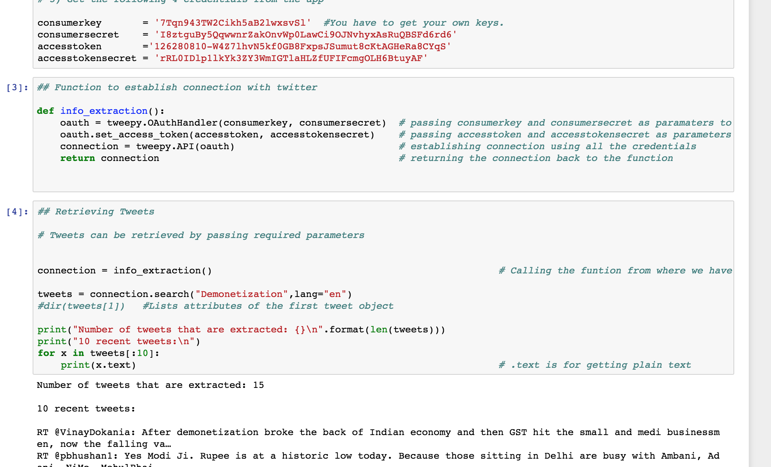
5) Data Preparation
Tweepy package was imported and have to register an app tp consume data from Twitter API

Slide 8
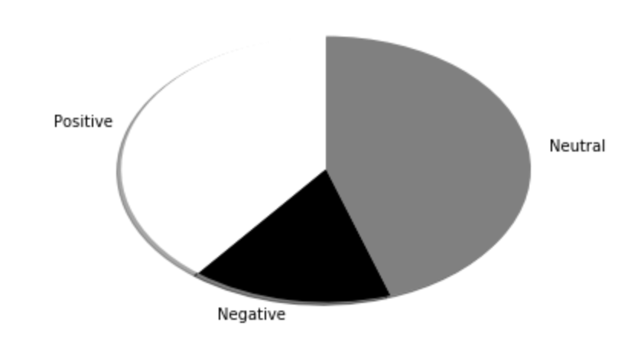
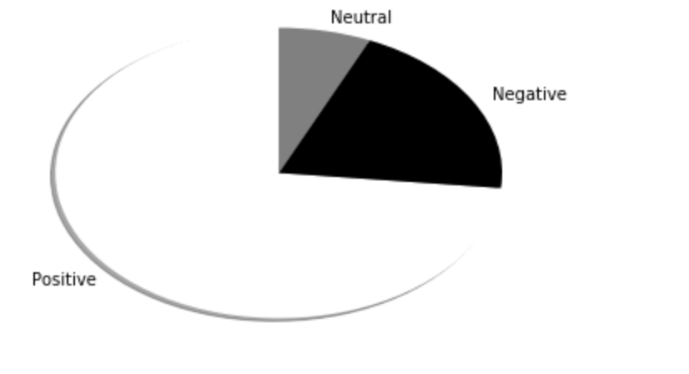
6)Insights through Sentimental Analysis
Sentiment through demonetisation (20th Nov -21st Nov 2016)
Sentiment through demonetisation in last week (28th June 2018)
People didn’t think highly of demonetisation when it was introduced. The reason of which can be the troubles it caused among a major section of people who didn’t use digitised money.
But there is certain change of heart!

Slide 9
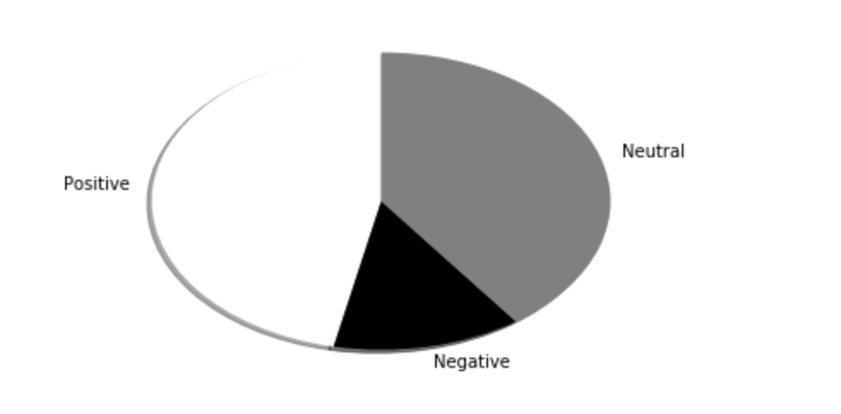
6)Insights through Sentimental Analysis
People have almost positive and neutral impact towards digital transactions in India.
Any 2G/ 3G scam may polarize the data but as of last week and many reruns of the code very less negative percentage is observed.
Hence seeing the need of digitisation and sentiment of people towards it we can say that cashless economy is positively supported government policy which needs to be implemented efficiently
Sentiment through digital transactions in last week (28th June 2018)

Slide 10
6)Insights through RBI data on various payment methods
NEFT : We can clearly see a peak from January 2017 and a stable increase thereafter in both volume and value , hence clearly depicting demonetization.

Slide 11
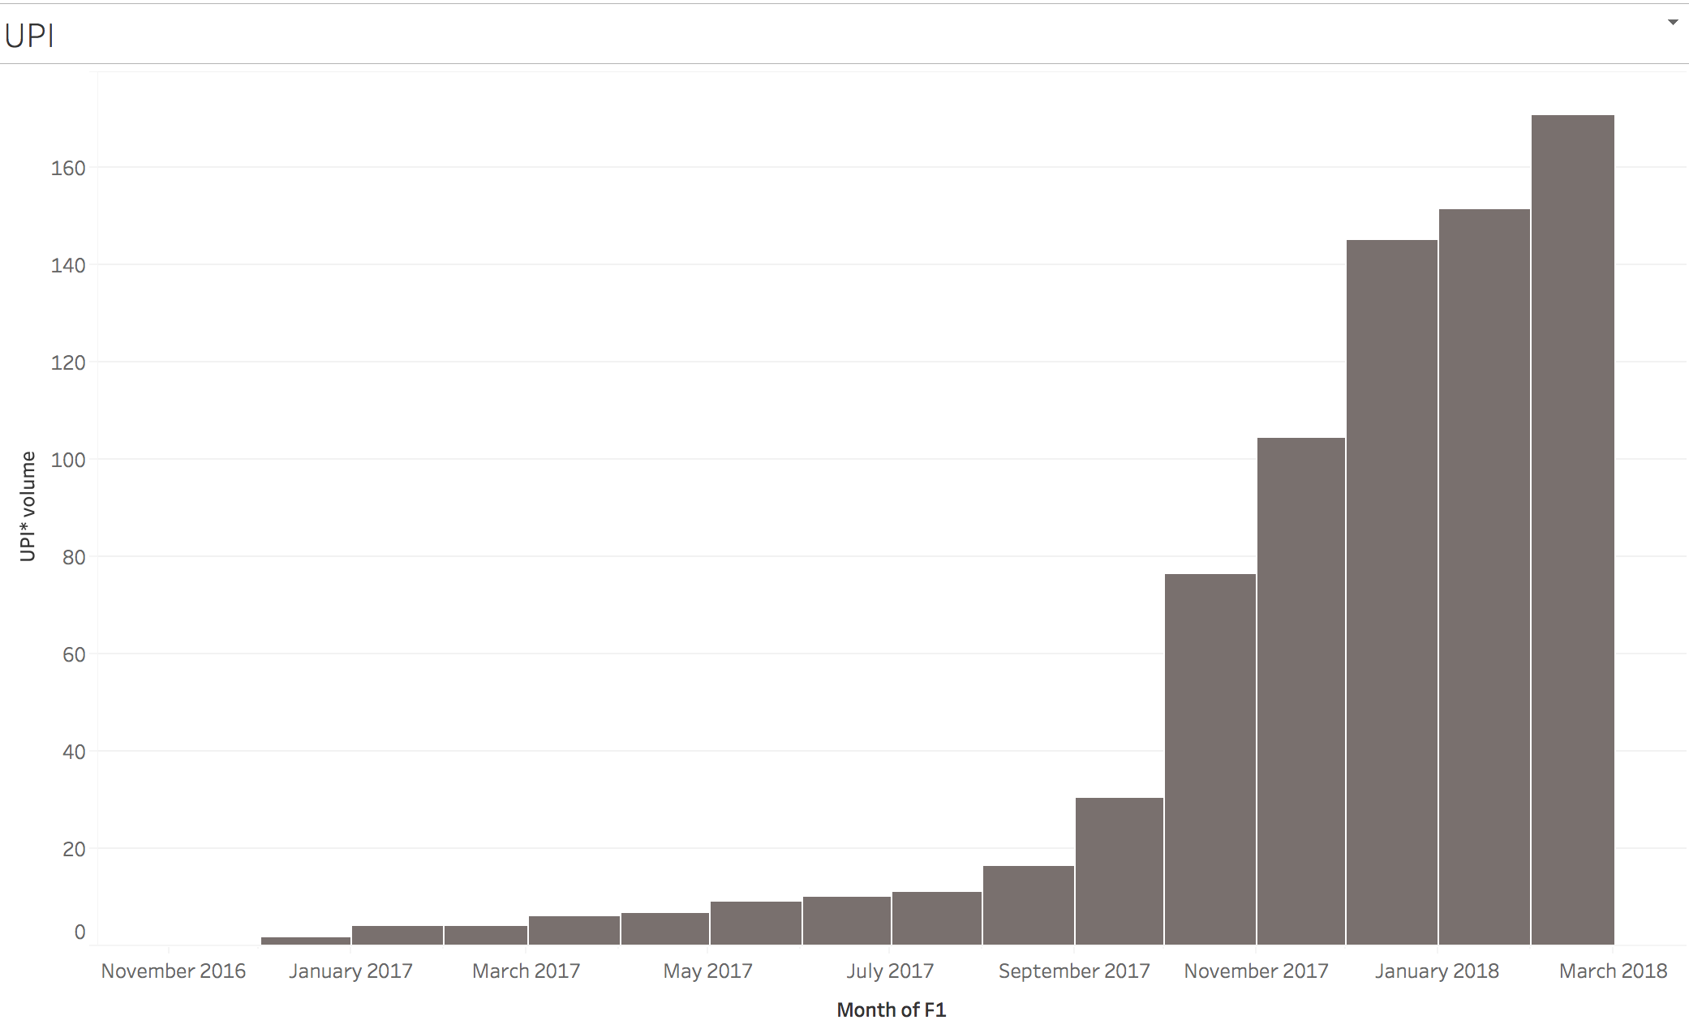
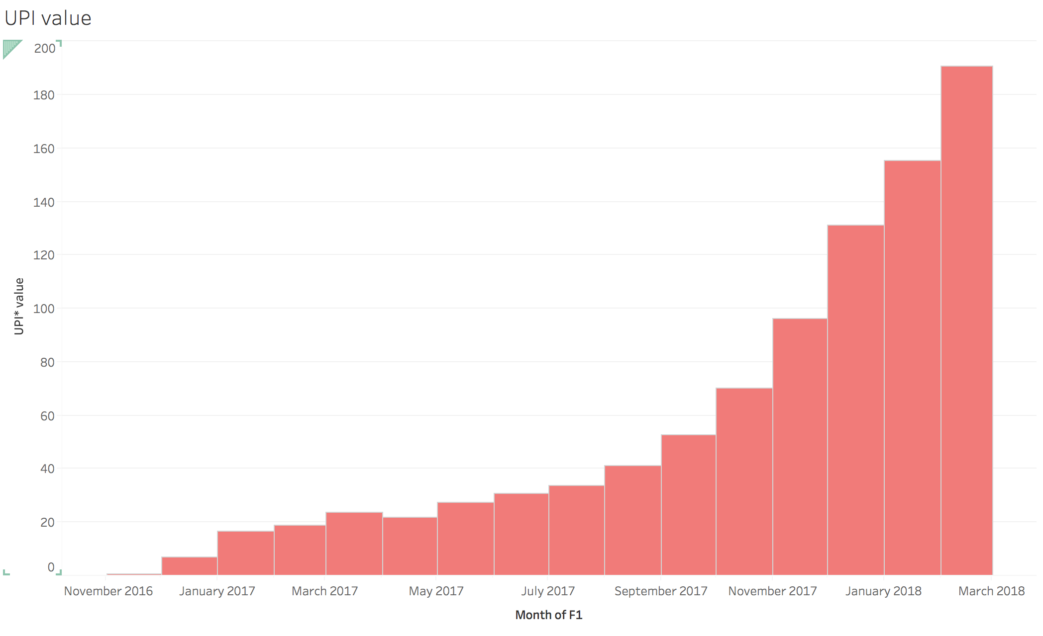
6)Insights through RBI data on various payment methods
UPI :UPI transactions seems to have an exponential increase in both volume and value and the reason for which could be attributed to their integration with Paytm, Tez etc around the same time.

Slide 12
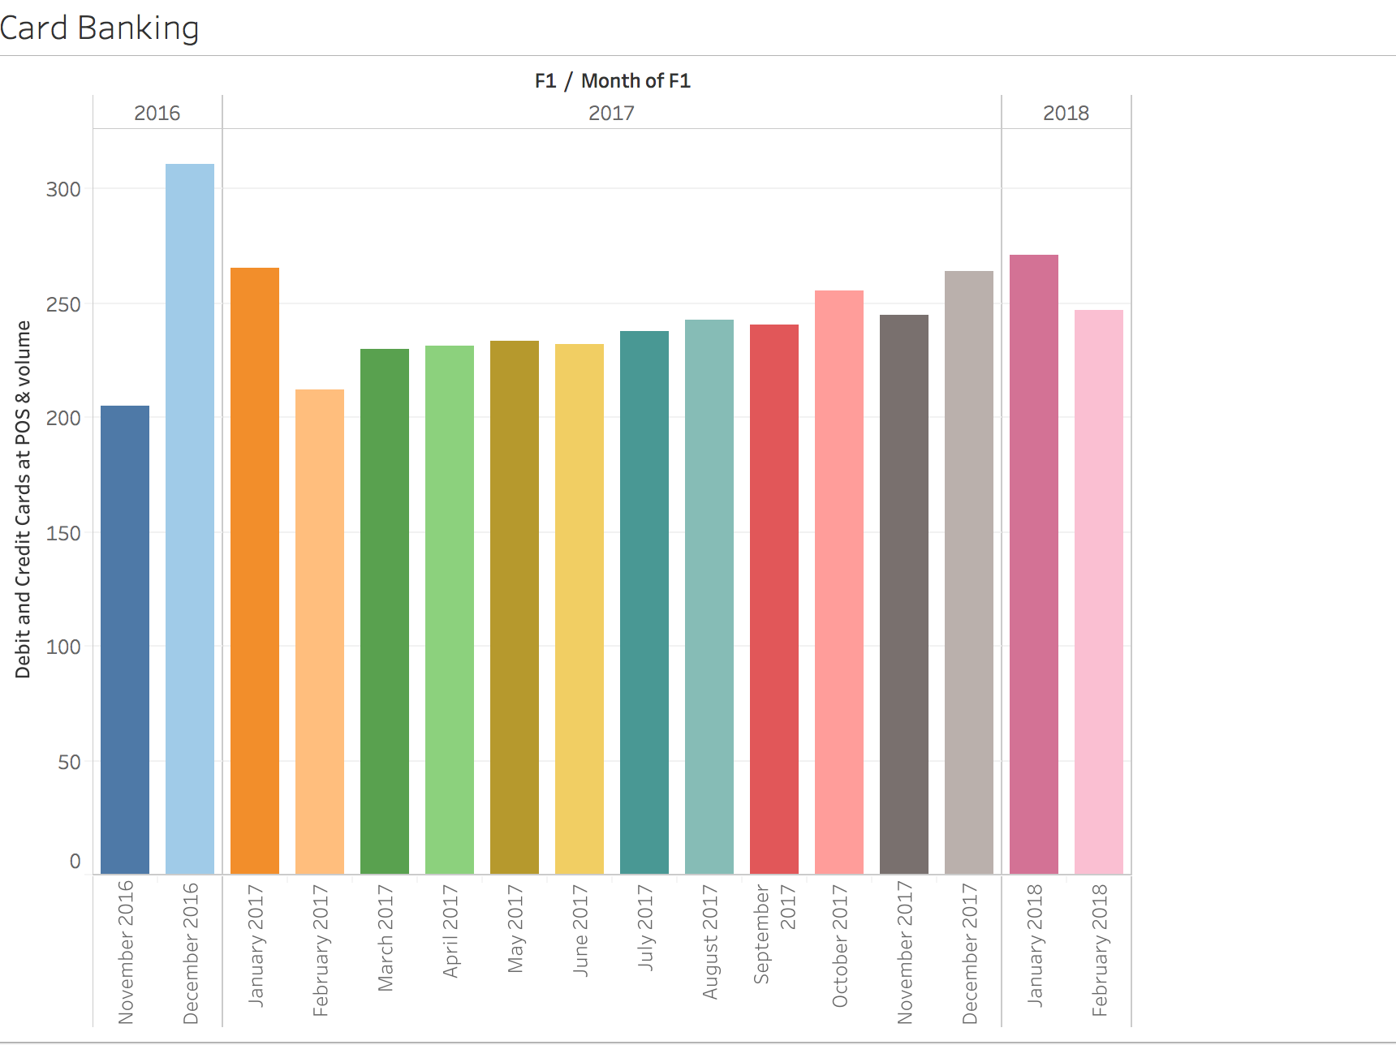
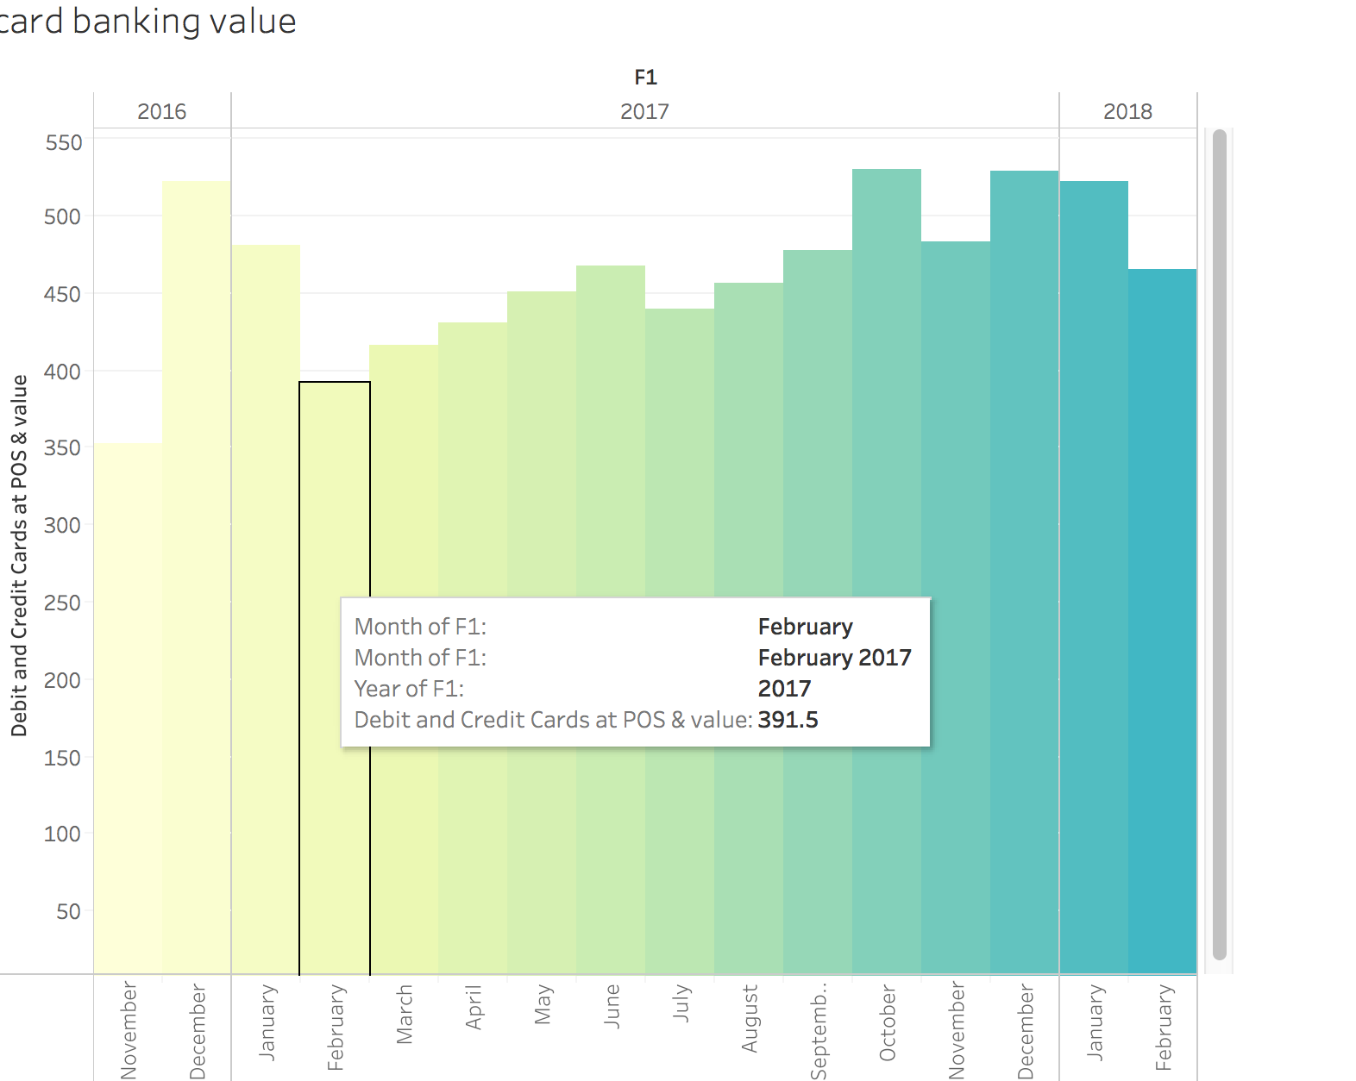
6)Insights through RBI data on various payment methods
Debit & Credit Cards: We can clearly see a peak in December 2017 which can be attributed to demonetization with ATM’s dried out, there was no option but cards for the general public because of its ease of use.

Slide 13
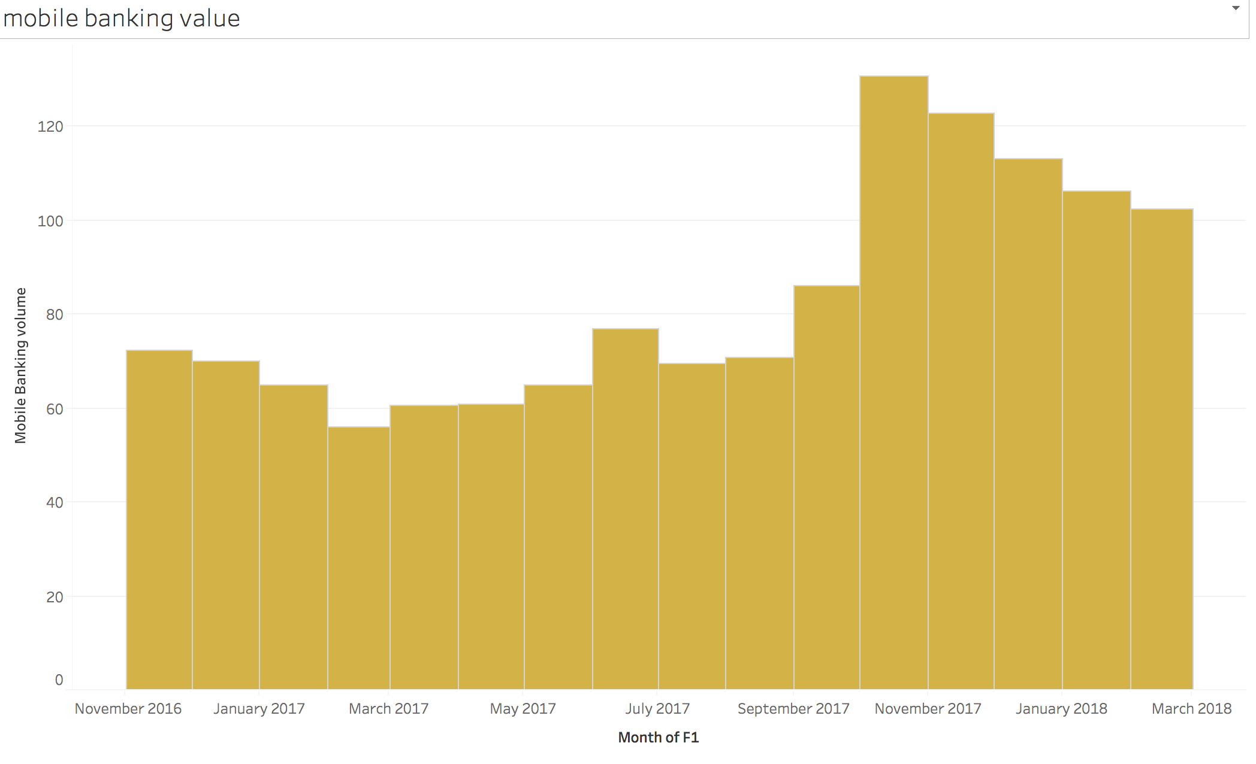
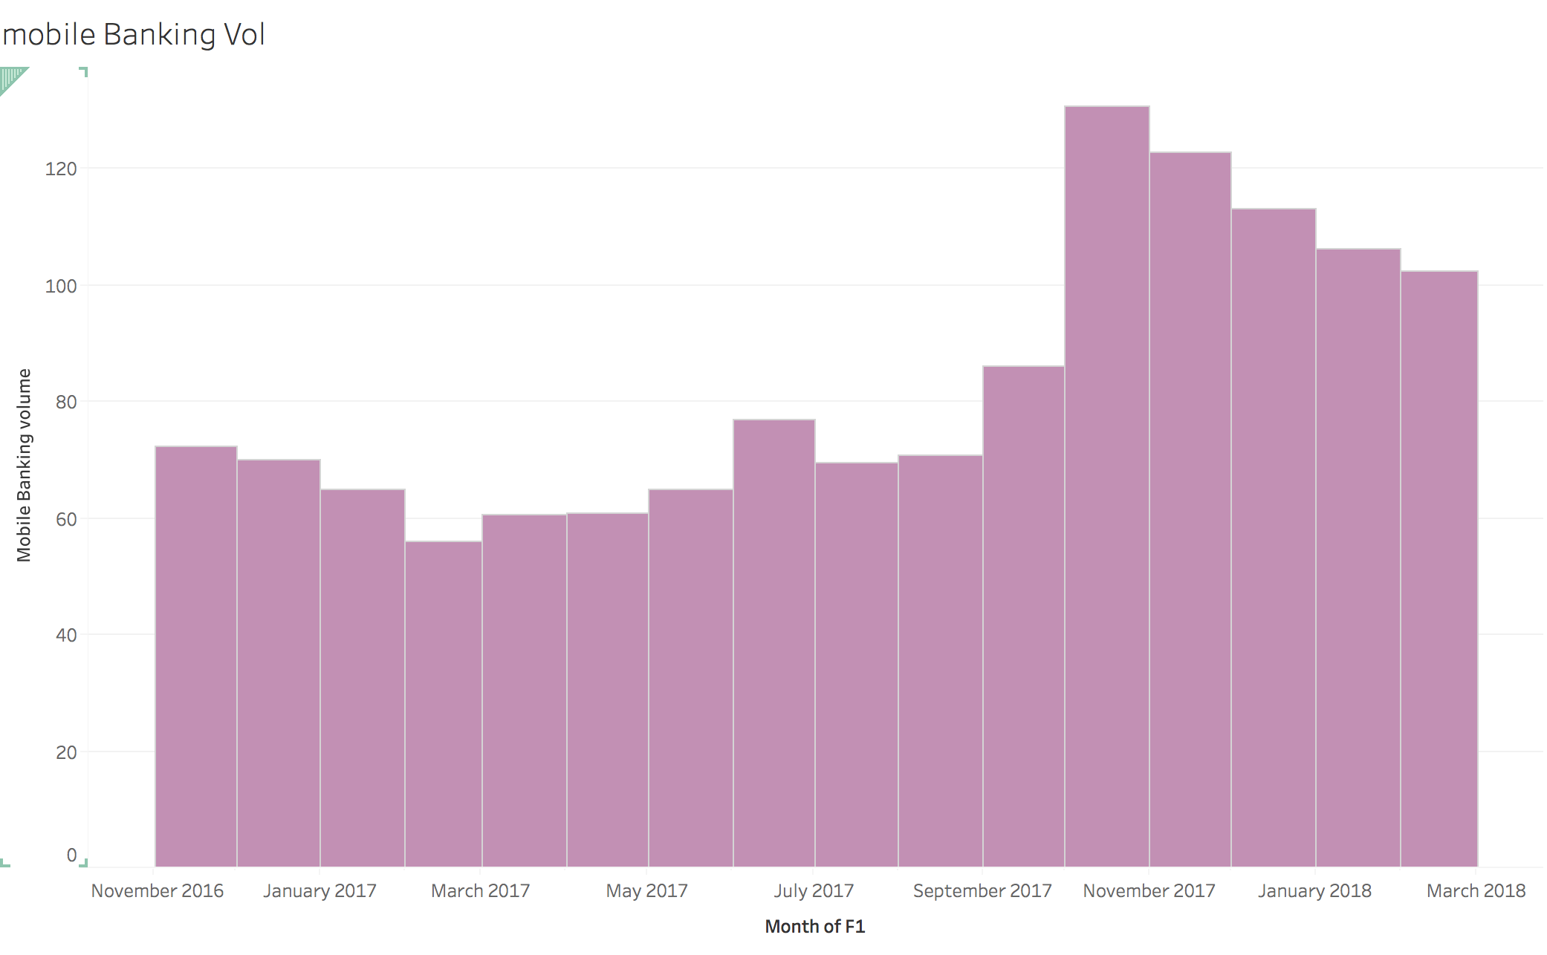
6)Insights through RBI data on various payment methods
Mobile Banking: Demonetisation still didn’t affect mobile banking much which gives us the human behavior that people still doesn’t trust online transactions through mobile and wallets.
But as we see a certain increase after October probably due to the reason of UPI integration into Paytm or paytm KYC. The trust factor seems to effect the numbers of both volume and value

Slide 14
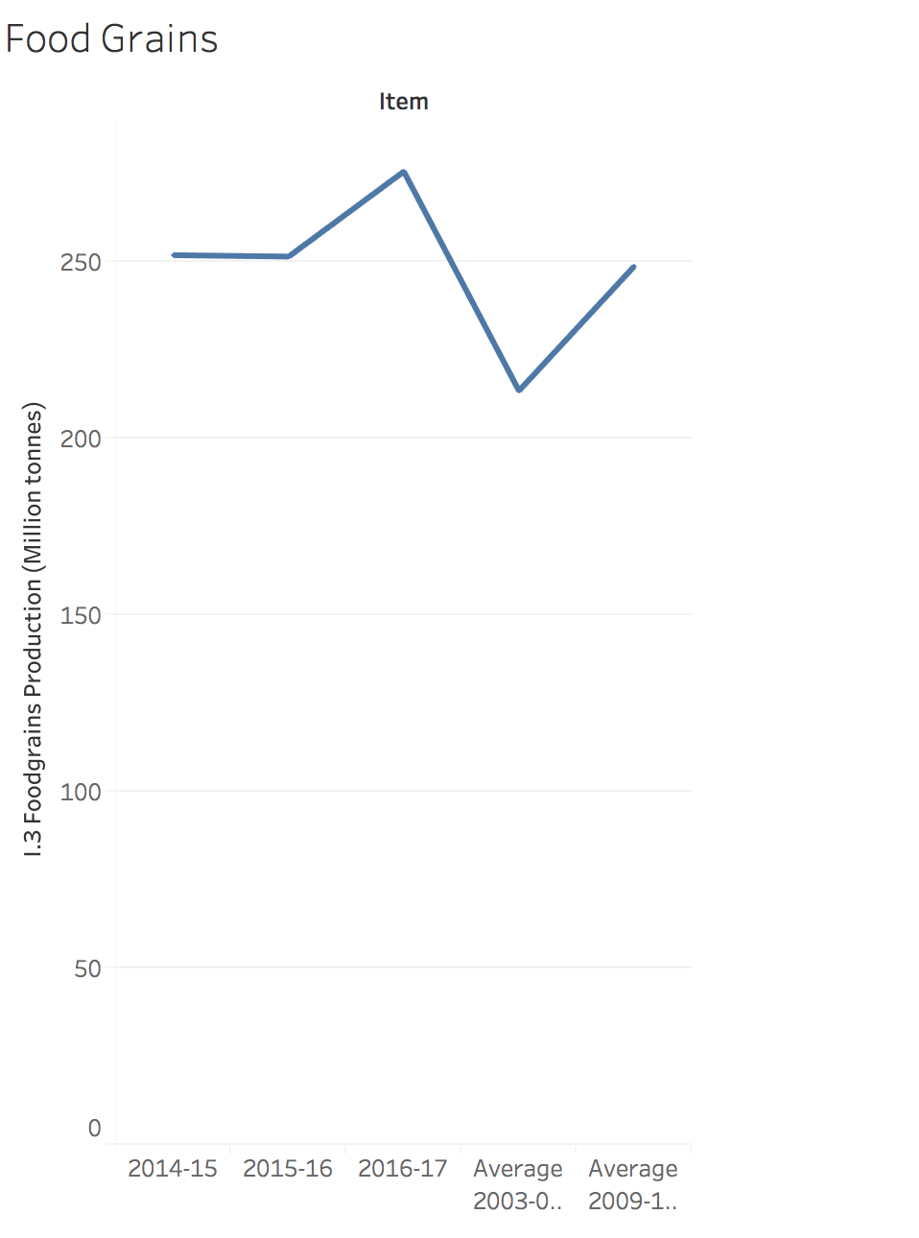
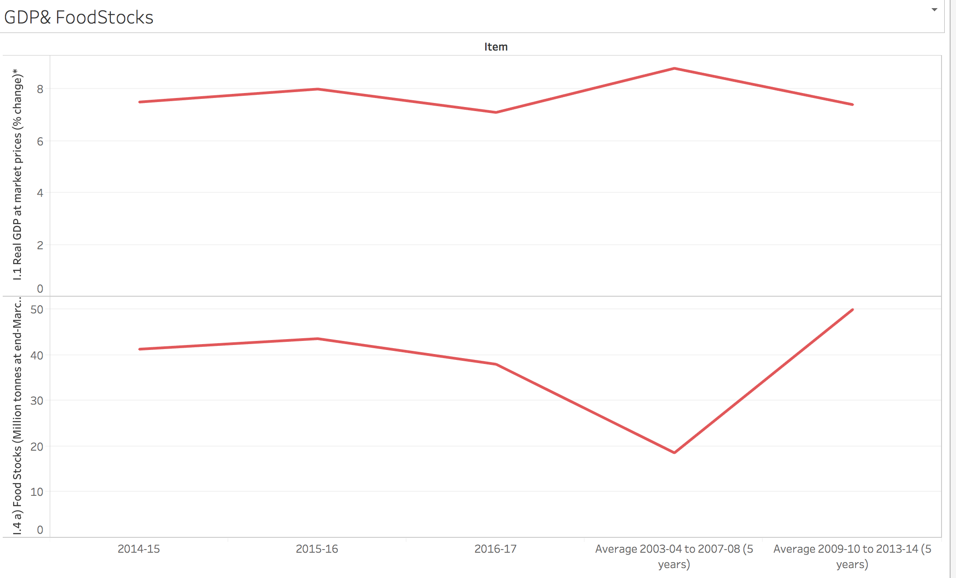
6)Insights through RBI data on various socio economic factors
GDP &Food Stocks: We see that 2016 behaves differently from the usual trend and has somehow affected the average too.
GDP has significantly dipped in 2016-2017 suggesting a major setback in economy, wounds of which are still healing.

Slide 15
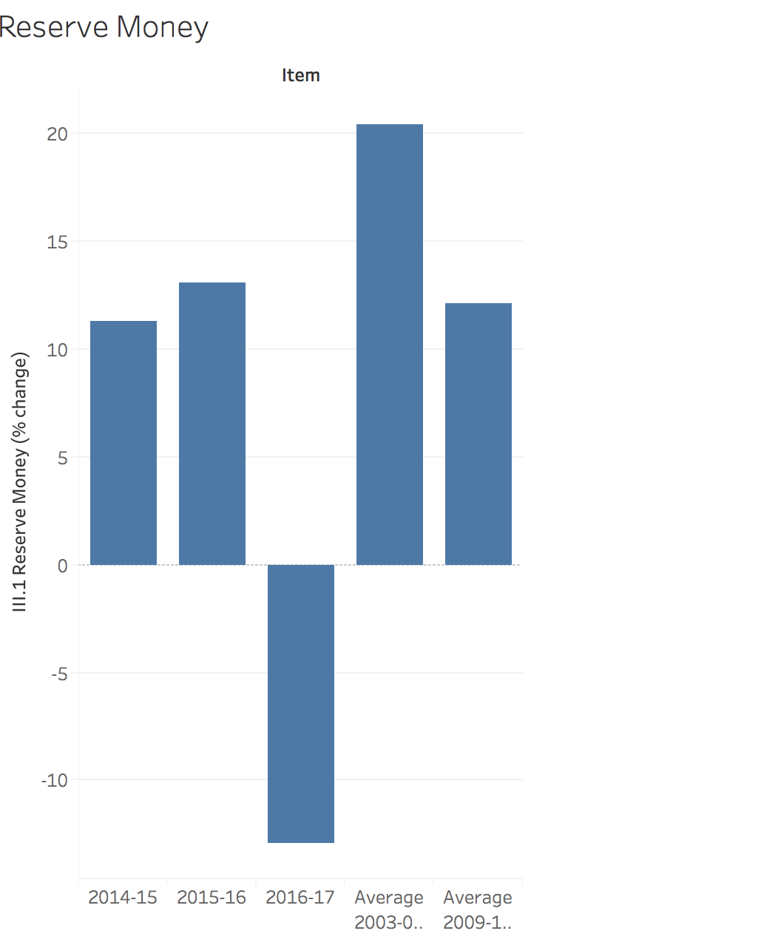
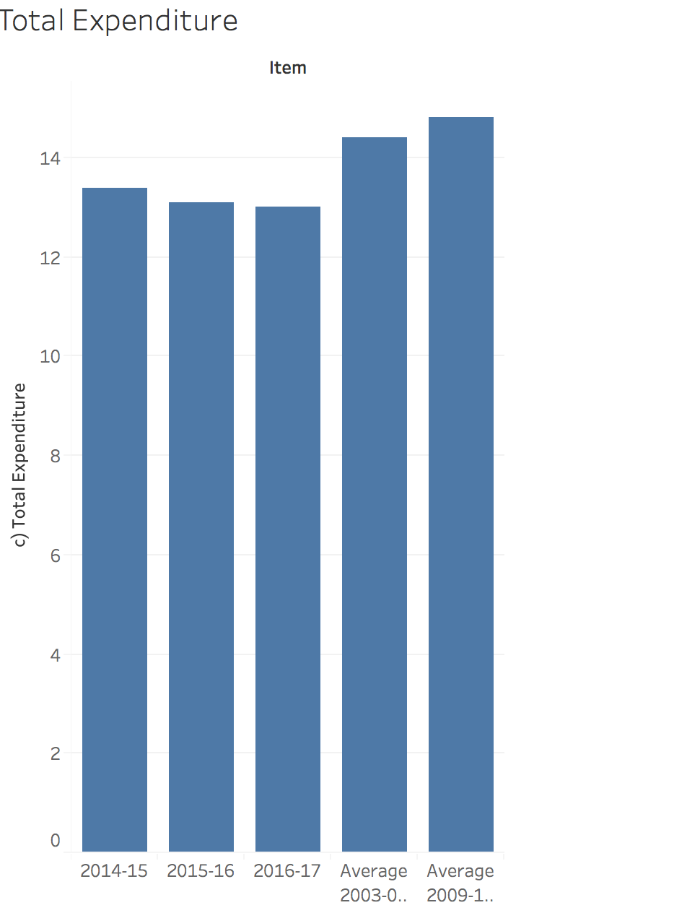
6)Insights through RBI data on various socio economic factors
Money Reserves & Total Expenditure: Total expenditure remaining the same over the years but the reserve money in the country seems to have a dip which clearly indicates a debt in the reserve money which is not a sign of a healthy economy.
This indicator might very feebly indicate sinking economy and increase in poverty.

Slide 16
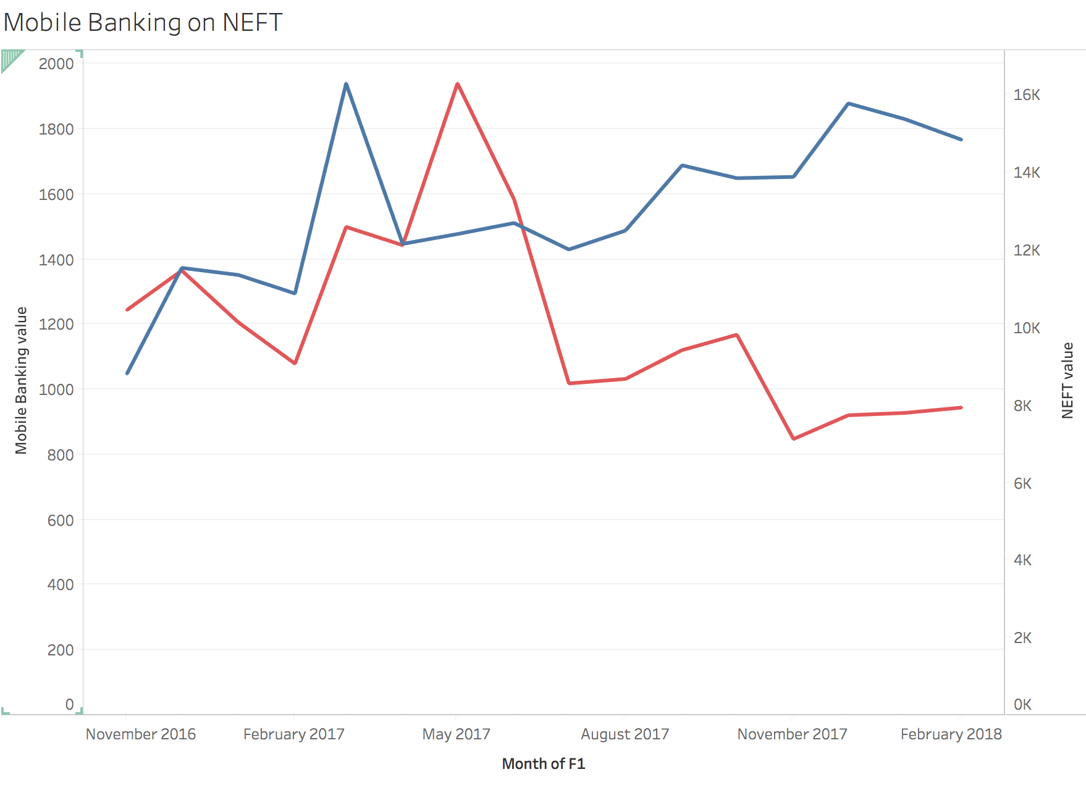
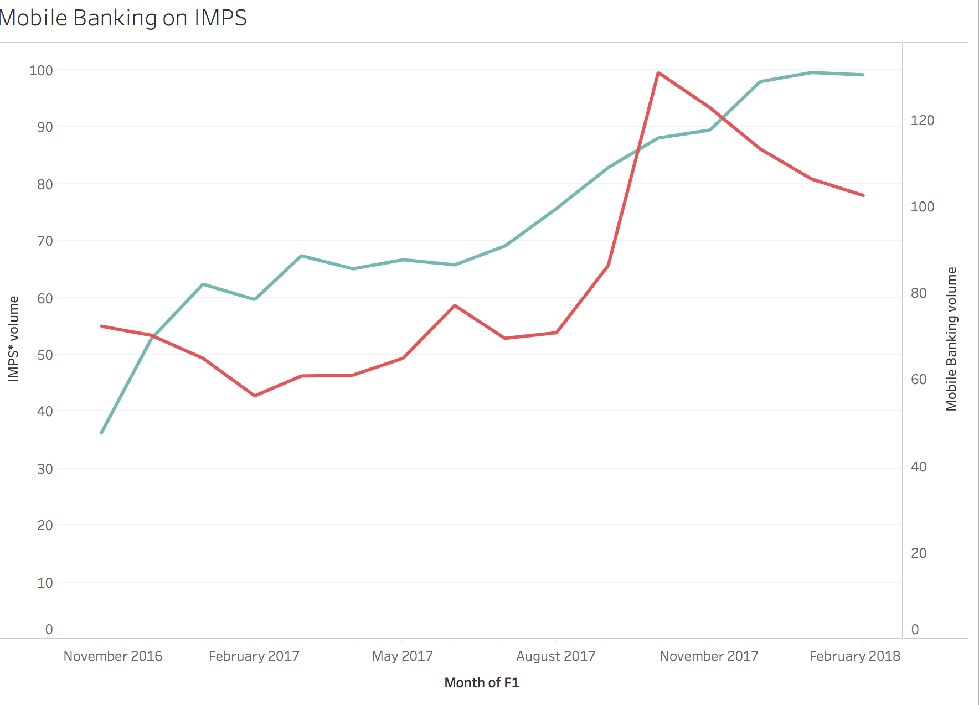
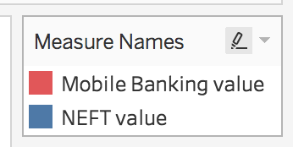
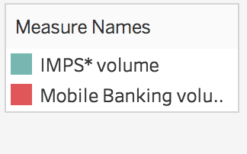
6)Comparison or effect of Mobile Banking on Various Payment methods.
We can clearly see the NEFT graph following the mobile banking while IMPS is certainly gaining more popularity as compared to NEFT and even off-charting mobile banking as whole..

Slide 17
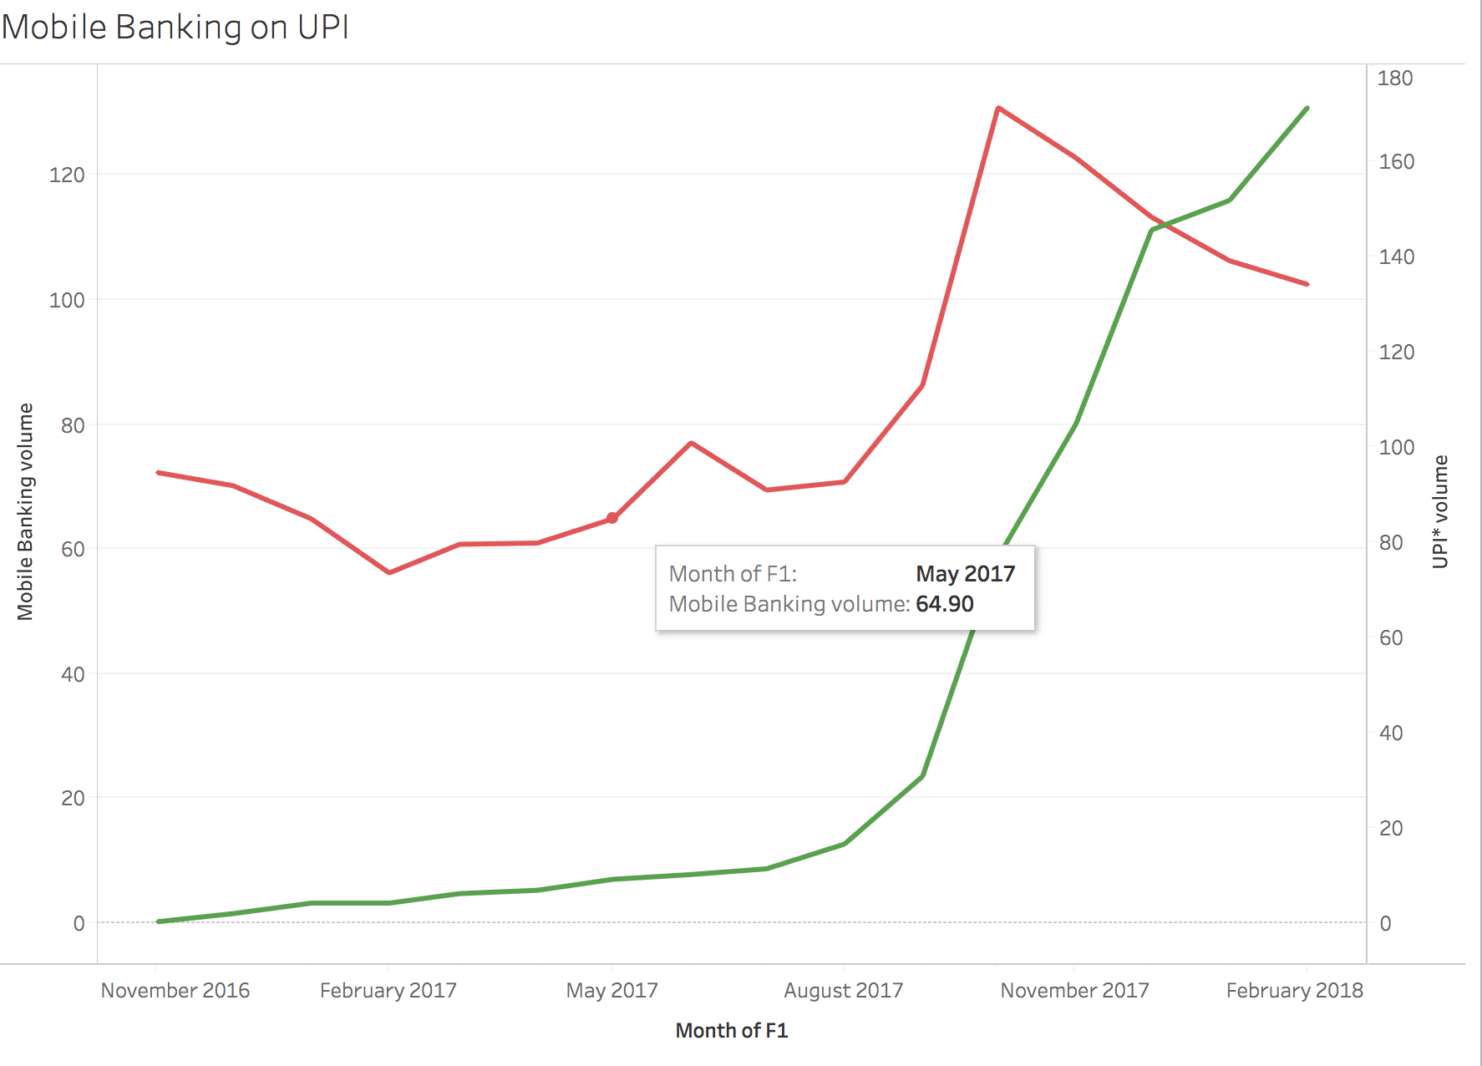
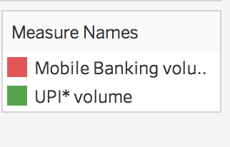
6)Comparison or effect of Mobile Banking on Various Payment methods.
We clearly see UPI’s growth was almost dormant before May 2017 and has exponentially increased in past few months.
This change of trend could be attributed to increase in trust people have towards UPI payment method and its integration with major payment wallets like PayPal , Tez, Paytm etc.

Slide 18
7)Conclusions
Demonetisation introduced as a policy has mixed effects on people, they were agitated in the start but have simply become accustomed to it today.
The positive effect of demonetisation has been the boom in cashless economy. People have now developed trust towards online and digital banking.
Demonetisation has hit economy for a brief amount of time but its on the path of its recovery.
With increase in mobile banking people are increasing usage of NEFT, IMPS etc.
Overall , demonetisation is a bygone demon who has left a little goodness in the form of digitisation.

Slide 19
8) Assumptions Limitations & Further Works
Assumptions:
Text Blob library is giving correct results for the polarity of tweets.
Limitations:
Frequent reruns of the code for sentimental analysis of the tweets of past week has observed different results.
Future Work:
To create a dictionary and model for analyzing the sentiment percentage which is best suited to the context of concerned topic.

